Slide 1
MLOps
Anshu Pandey

Slide 2

Introduction
Anshu Pandey
AI & Data Consultant
10+ years of experience as Data Scientists, AI Consultant and Architect
MCT, WCT, 10+ other certifications

Slide 3

Introduction
Tell more about yourself
Your experience with
python, Azure cloud
Machine Learning
Spark
Your expectation from this course

Slide 4
Common challenges with ML
Cross-team alignment: Siloed teams impede workflow alignment and collaboration.
Standard, repeatable processes: Without automated and repeatable processes, employees have to reinvent the wheel each time they create and deploy a new model.
Resources: Large amounts of time and personnel are required to manage the lifecycle.
Auditability: It can be difficult to ensure that models meet regulatory standards and performance thresholds over time.
Explainability: Black box models make it difficult to understand how the model works.

Slide 5
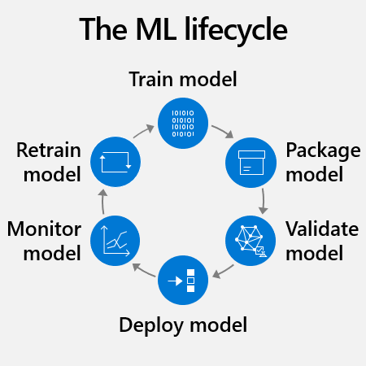
Typical ML model lifecycle

Slide 6
What is MLOps?
MLOps stands for Machine Learning Operations. It is an approach to managing the lifecycle of machine learning models that emphasizes collaboration, automation, and monitoring.
MLOps aims to bridge the gap between data science and IT operations by applying principles and practices from software engineering to machine learning development and deployment.
MLOps involves various tasks, such as data preparation, model training, deployment, monitoring, and maintenance, and relies on tools and technologies such as version control, continuous integration and deployment (CI/CD), containerization, and orchestration platforms.
MLOps helps organizations to build and deploy machine learning models more efficiently, reliably, and at scale, while reducing risks and costs associated with machine learning projects.

Slide 7
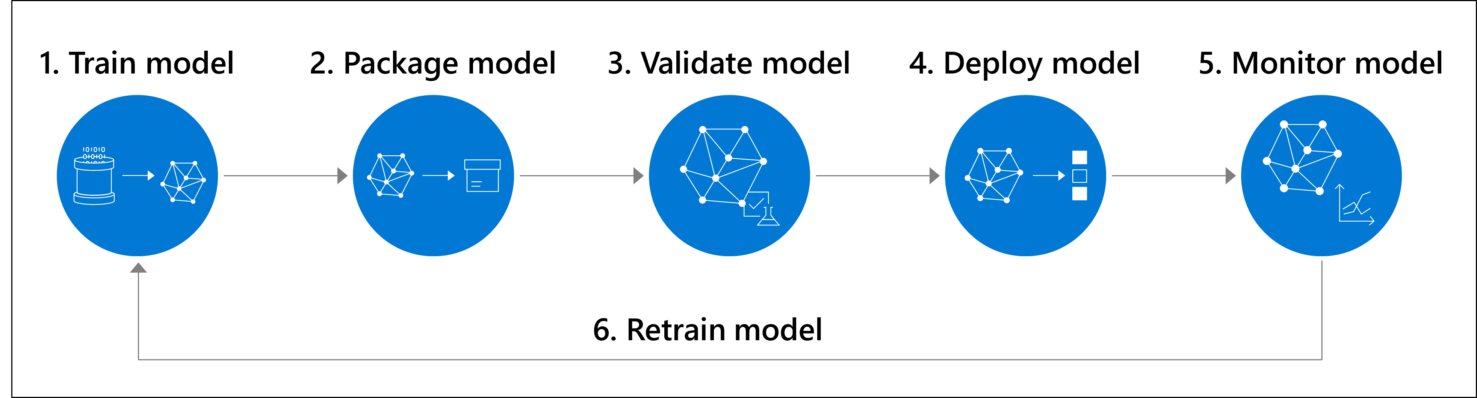
What is MLOps?
Machine learning operations or MLOps aims to more efficiently scale from a proof of concept or pilot project to a machine learning workload in production.

Slide 8
Why MLOps
Improved collaboration: MLOps promotes collaboration between data scientists, software engineers, and operations teams, enabling them to work together more effectively and efficiently
Faster time to market: By automating many of the tasks involved in model development and deployment, MLOps can help organizations bring new machine learning models to market more quickly.
Better model performance: MLOps emphasizes continuous monitoring and optimization of machine learning models, helping to ensure that they continue to operate effectively over time.
Reduced costs: By automating many of the tasks involved in model development and deployment, MLOps can help organizations reduce the costs associated with managing machine learning models.
Improved reliability: MLOps promotes the use of best practices for testing, deployment, and monitoring, helping to ensure that machine learning models operate reliably in production environments.

Slide 9
Principles of MLOps
Collaboration
MLOps emphasizes collaboration between data scientists, software engineers, and operations teams. By working together, these teams can ensure that machine learning models are built and deployed effectively.
Automation
MLOps promotes the use of automation to streamline the development and deployment of machine learning models. Automation can help to reduce the time and effort required to manage these models, and can improve their reliability and performance.
Version Control
MLOps relies on version control to manage changes to machine learning models and related code. Version control helps to ensure that all changes are tracked and documented, and can help to facilitate collaboration among team members.
Testing
MLOps emphasizes the importance of testing machine learning models to ensure that they are working correctly. Testing can help to identify and address issues before they become problems in production environments.
Monitoring
MLOps promotes continuous monitoring of machine learning models in production environments. This can help to identify issues and opportunities for optimization, and can help to ensure that the models continue to operate effectively over time.
Deployment
MLOps emphasizes the importance of automating the deployment of machine learning models to production environments. This can help to reduce the risk of errors and ensure that models are deployed consistently across different environments.

Slide 10
Tasks involved in MLOps
Data preprocessing
Cleaning, transforming, and organizing data so that it can be used for training and evaluation.
Example: Removing missing values from a dataset, normalizing numerical features, and encoding categorical variables.
Model selection
Choosing the appropriate algorithm and hyperparameters to create models that meet specific business and technical requirements.
Example: Deciding whether to use a linear regression or a decision tree algorithm to predict sales, and selecting appropriate values for parameters such as learning rate or regularization.
Model training
Using data to train models, and optimizing them for specific use cases.
Example: Using historical sales data to train a machine learning model that predicts future sales, and adjusting the model's parameters to maximize accuracy.

Slide 11
Tasks involved in MLOps
Model Testing
Integrating models into production environments, often using containerization technologies such as Docker, and ensuring they can scale and operate reliably.
Example: Deploying a machine learning model as a web service that can be accessed by other applications, and monitoring its performance to ensure it meets service level agreements.
Model monitoring
Collecting and analyzing data on model performance, identifying potential issues or problems, and responding quickly to minimize any impact on users.
Example: Monitoring a machine learning model's predictions over time, and detecting if its accuracy starts to degrade or if it starts to produce biased results.
Model optimization
Continuously improving models by refining algorithms, tweaking hyperparameters, and incorporating new data or feedback from users.
Example: Incorporating customer feedback into a machine learning model that recommends products, and adjusting the model's parameters to better reflect user preferences.
Model deployment
Model explanation, Biasness Analysis, Fairness Analysis, response time, packaing, environment, dependencies etc.
Example: Performing detailed testing on model to ensure it matches business requirements

Slide 12
Tools for MLOps
Mlflow
MLflow is an open-source platform for managing the lifecycle of machine learning models. It provides tools for tracking experiments, packaging code, and deploying models.
Apache Airflow
Apache Airflow is an open-source platform for creating, scheduling, and monitoring workflows. It provides a way to automate the steps involved in building and deploying machine learning models, including data ingestion, model training, and model deployment.

Slide 13
Tools for MLOps
Docker
Docker is a containerization platform that is commonly used in MLOps to package and deploy machine learning models. With Docker, machine learning models can be packaged into a container image, along with all the dependencies needed to run the model. This makes it easy to deploy the model to any environment that supports Docker, such as a cloud platform or on-premise server.
Kubeflow
Kubeflow is an open-source platform for building and deploying machine learning workflows on Kubernetes. It provides tools for model training, serving, and monitoring, as well as tools for managing data pipelines and model artifacts.

Slide 15
Agenda
Introduction to Model Interpretability
Using Model Explainers

Slide 16













Lesson 1
Introduction to Model Interpretability
Data
Cloud
AI

Slide 17
Model Interpretability in Azure Machine Learning
Statistical explanation of feature importance
Quantifies the influence of each feature on prediction
Important to identify bias or unintended correlation in the model
Based on the Open Source Interpret-Community package
Includes explainers based on common model interpretation algorithms like:
Shapely Additive Explanations (SHAP)
Local Interpretable Model-Agnostic Explanations (LIME)

Slide 18
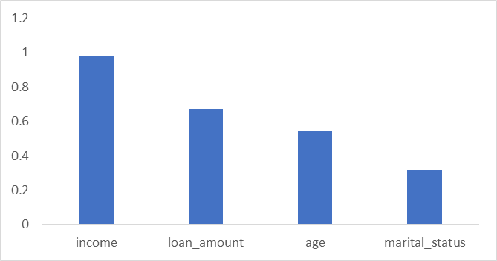
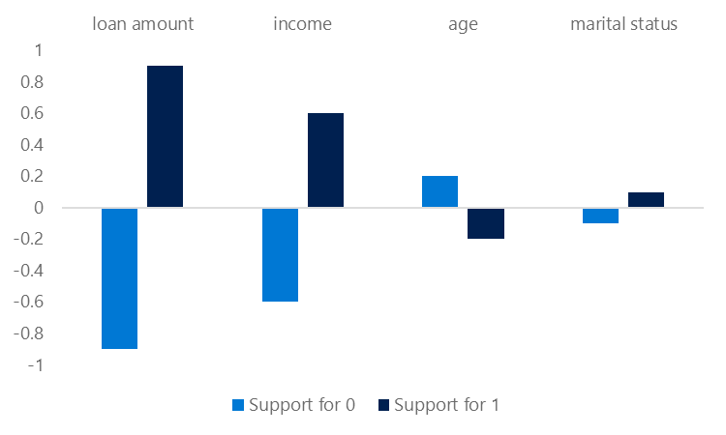
Global and Local Feature Importance
Global Feature Importance
Overall feature importance for all test data
Indicates ther relative influence of each feature on the predicted label
Local Feature Importance
Feature importance for an individual prediction
In classification, this shows the relative support for each possible class per feature

Slide 19
Automated Machine Learning Explanations
Enable model_explanability parameter
View explanations:
Azure Machine Learning studio
RunDetails widget in Jupyter
SDK ExplanationClient class
automl_config = AutoMLConfig(name='Automated ML Experiment',
...,
model_explanability=True)
best_run, fitted_model = automl_run.get_output()
client = ExplanationClient.from_run(best_run)
explanation = client.download_model_explanation()
feature_importances = explanation.get_feature_importance_dict()

Slide 20
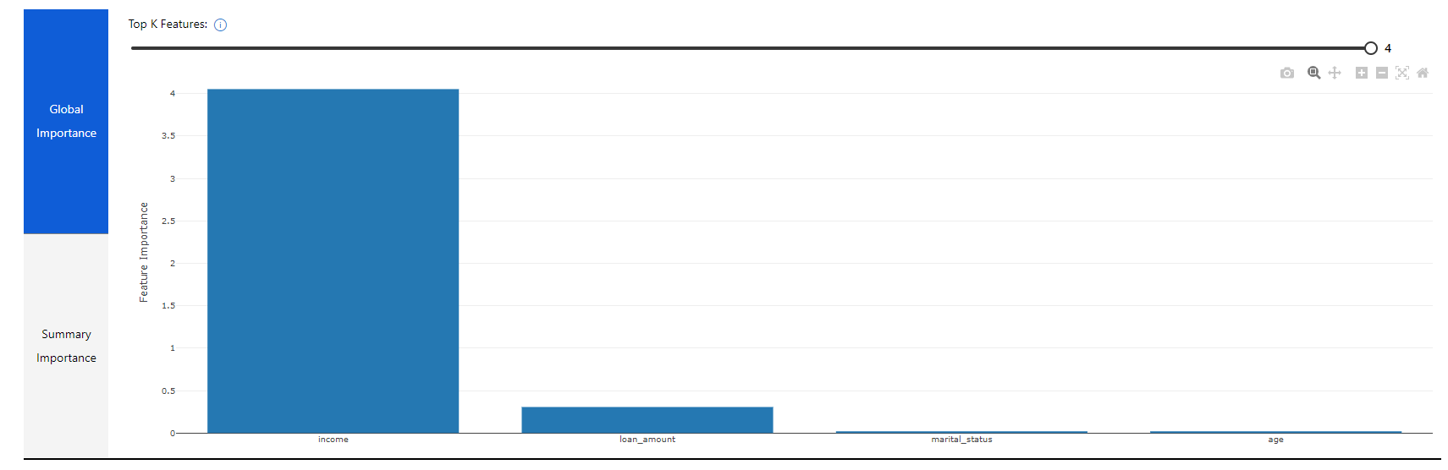
Visualizing Model Explanations
View the Explanations tab for the run in Azure Machine Learning studio

Slide 21
Lab 9A
Reviewing Automated Machine Learning Explanations
https://aka.ms/msl-dp100

Slide 22
Lesson Review
Complete the Review Questions

Slide 23
Lesson 2
Using Model Explainers
Data
Cloud
AI

Slide 24
Local Model Interpretation
Use the azureml-interpret package
Create an explainer:
MimicExplainer – global surrogate model that approximates your model
TabularExplainer – Invokes direct SHAP explainer based on model architecture
PFIExplainer – Permutation Feature Importance based on feature shuffling
Get global or local feature explanations
from interpret.ext.blackbox import TabularExplainer
tab_explainer = TabularExplainer(model, X_train, features=features, classes=labels)
global_explanation = tab_explainer.explain_global(X_train)

Slide 25
Adding Interpretability to Training Experiments
In the training script, import the ExplanationClient class
Generate explanations and upload them to the run
Use ExplanationClient to download explanations
explain_client = ExplanationClient.from_run(run)
explainer = MimicExplainer(model, X_train, LinearExplainableModel,
features=features, classes=labels)
explanation = explainer.explain_global(X_test)
explain_client.upload_model_explanation(explanation, comment='Model Explanation')
from azureml.contrib.interpret.explanation.explanation_client import ExplanationClient
client = ExplanationClient.from_run_id(workspace=ws,
experiment_name=experiment.experiment_name,
run_id=run.id)
explanation = client.download_model_explanation()

Slide 26
Interpretability During Inferencing
Register a lightweight scoring explainer with the model
Use the model and the explainer in the service scoring script
Deploy a service with the model and explainer
scoring_explainer = KernelScoringExplainer(explainer)
save(scoring_explainer, directory='dir', exist_ok=True)
Model.register(ws, model_name='model', model_path='dir/model.pkl')
Model.register(ws, model_name='explainer', model_path='dir/scoring_explainer.pkl')
def run(raw_data):
data = json.loads(raw_data)['data']
predictions = model.predict(data)
local_importance_values = explainer.explain(data)
return {"predictions":predictions.tolist()), "importance":local_importance_values}
service = Model.deploy(ws, 'classify_svc', [model, explainer], inf_config, dep_config)

Slide 27
Model fairness
When we consider the concept of fairness concerning predictions made by machine learning models, it helps to be clear about what we mean by "fair".
For example, suppose a classification model is used to predict the probability of successful loan repayment and therefore influences whether or not the loan is approved. The model will likely be trained using features that reflect the characteristics of the applicant, such as:
Age
Employment status
Income
Savings
Current debt

Slide 28
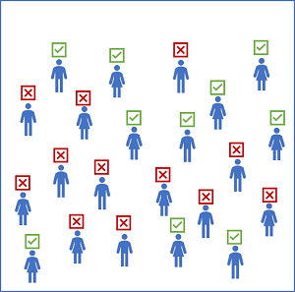
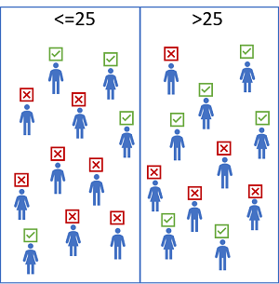
Example

Slide 29
Potential causes of disparity
Data imbalance. Some groups may be overrepresented in the training data, or the data may be skewed so that cases within a specific group aren't representative of the overall population.
Indirect correlation. The sensitive feature itself may not be predictive of the label, but there may be a hidden correlation between the sensitive feature and some other feature that influences the prediction. For example, there's likely a correlation between age and credit history, and there's likely a correlation between credit history and loan defaults. If the credit history feature is not included in the training data, the training algorithm may assign a predictive weight to age without accounting for credit history, which might make a difference to loan repayment probability.
Societal biases. Subconscious biases in the data collection, preparation, or modeling process may have influenced feature selection or other aspects of model design.

Slide 30
Mitigating Bias
Optimizing for fairness in a machine learning model is a sociotechnical challenge. In other words, it's not always something you can achieve purely by applying technical corrections to a training algorithm. However, there are some strategies you can adopt to mitigate bias, including:
Balance training and validation data. You can apply over-sampling or under-sampling techniques to balance data and use stratified splitting algorithms to maintain representative proportions for training and validation.
Perform extensive feature selection and engineering analysis. Make sure you fully explore the interconnected correlations in your data to try to differentiate features that are directly predictive from features that encapsulate more complex, nuanced relationships. You can use the model interpretability support in Azure Machine Learning to understand how individual features influence predictions.
Evaluate models for disparity based on significant features. You can't easily address the bias in a model if you can't quantify it.
Trade-off overall predictive performance for the lower disparity in predictive performance between sensitive feature groups. A model that is 99.5% accurate with comparable performance across all groups is often more desirable than a model that is 99.9% accurate but discriminates against a particular subset of cases.

Slide 31
Mitigation algorithms and parity constraints
The mitigation support in Fairlearn is based on the use of algorithms to create alternative models that apply parity constraints to produce comparable metrics across sensitive feature groups. Fairlearn supports the following mitigation techniques.
Technique | Description | Model type support
Exponentiated Gradient | A reduction technique that applies a cost-minimization approach to learning the optimal trade-off of overall predictive performance and fairness disparity | Binary classification and regression
Grid Search | A simplified version of the Exponentiated Gradient algorithm that works efficiently with small numbers of constraints | Binary classification and regression
Threshold Optimizer | A post-processing technique that applies a constraint to an existing classifier, transforming the prediction as appropriate | Binary classification

Slide 34
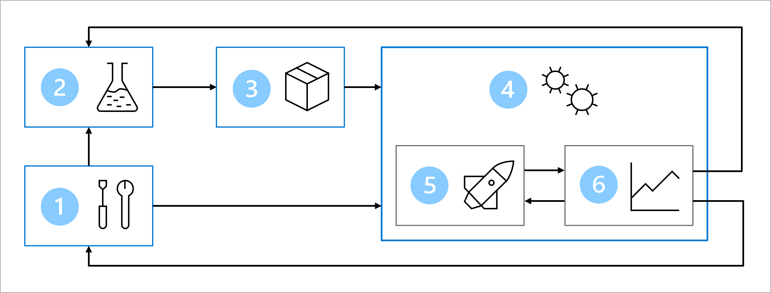
MLOps Architecture
Setup: Create all necessary Azure resources for the solution.
Model development (inner loop): Explore and process the data to train and evaluate the model.
Continuous integration: Package and register the model.
Model deployment (outer loop): Deploy the model.
Continuous deployment: Test the model and promote to production environment.
Monitoring: Monitor model and endpoint performance.

Slide 35
Convert a notebook to a script
Scripts are ideal for testing and automation in your production environment. To create a production-ready script, you'll need to:
Remove nonessential code.
Refactor your code into functions.
Test your script in the terminal.

Slide 36
Remove all nonessential code
The main benefit of using notebooks is being able to quickly explore your data. For example, you can use print() and df.describe() statements to explore your data and variables. When you create a script that will be used for automation, you want to avoid including code written for exploratory purposes.
The first thing you therefore need to do to convert your code to production code is to remove the nonessential code. Especially when you'll run the code regularly, you want to avoid executing anything nonessential to reduce cost and compute time.

Slide 37
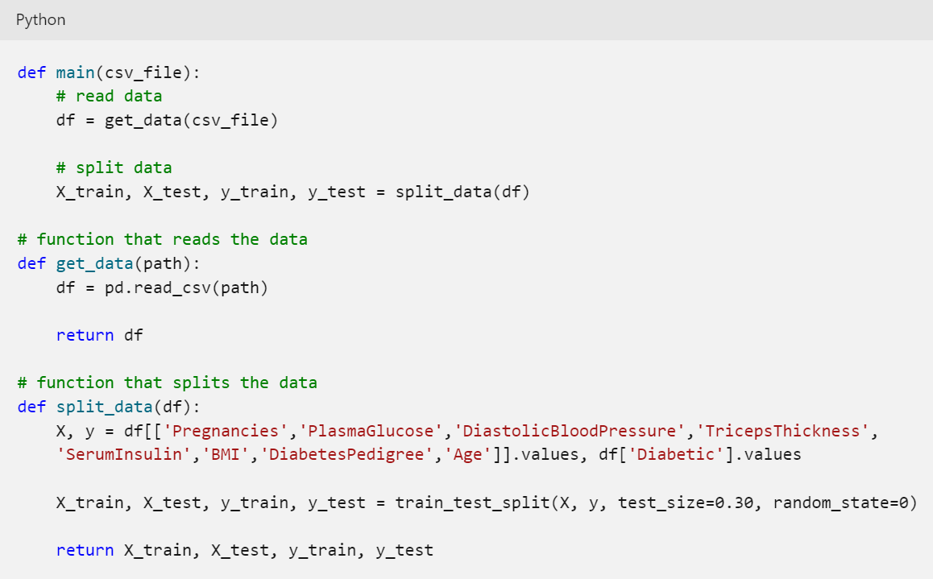
Refactor your code into functions

Slide 38
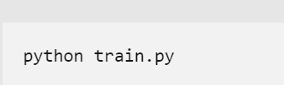
Test your script
Before using scripts in production environments, for example by integrating them with automation pipelines, you'll want to test whether the scripts work as expected.

Slide 39
Azure CLI
Download: https://learn.microsoft.com/en-us/cli/azure/install-azure-cli-windows?tabs=azure-cli
Setup
az login
az account set -s "<YOUR_SUBSCRIPTION_NAME_OR_ID>“
az extension add -n ml –y
az ml -h

Slide 40
Workspace creation with CLI
az ml workspace create --resource-group
[--application-insights]
[--container-registry]
[--description]
[--display-name]
[--file]
[--image-build-compute]
[--location]
[--managed-network]
[--name]
[--no-wait]
[--primary-user-assigned-identity]
[--public-network-access]
[--set]
[--tags]
[--update-dependent-resources]

Slide 41
Workspace creation with CLI
az ml workspace create --resource-group
[--application-insights]
[--container-registry]
[--description]
[--display-name]
[--file]
[--image-build-compute]
[--location]
[--managed-network]
[--name]
[--no-wait]
[--primary-user-assigned-identity]
[--public-network-access]
[--set]
[--tags]
[--update-dependent-resources]

Slide 42
Creating compute with CLI
Create a compute instance
az ml compute create --name "testdev-vm" --size STANDARD_DS11_V2 --type ComputeInstance
Create a compute cluster
az ml compute create --name "aml-cluster" --size STANDARD_DS11_V2 --max-instances 2 --type AmlCompute

Slide 43
Creating environment
az ml environment create --file my_env.yml --resource-group my-resource-group --workspace-name my-workspace
Options: https://learn.microsoft.com/en-us/cli/azure/ml/environment?view=azure-cli-latest#az-ml-environment-create

Slide 44
Create data asset
az ml data create --name my-data --version 1 --path ./my-data.csv --resource-group my-resource-group --workspace-name my-workspace
az ml data create [--datastore]
[--description]
[--file]
[--name]
[--no-wait]
[--path]
[--registry-name]
[--resource-group]
[--set]
[--skip-validation]
[--type {mltable, uri_file, uri_folder}]
[--version]
[--workspace-name]

Slide 45
Running a job
$schema: https://azuremlschemas.azureedge.net/latest/commandJob.schema.json
code:
local_path: src
command: >-
python main.py
environment: azureml:basic-env-scikit:1
compute: azureml:testdev-vm
experiment_name: customer-churn
description: Train a classification model on a sample customer dataset.
az ml job create --file job.yml --web

Slide 46
Creating service principal
az ad sp create-for-rbac --name "<service-principal-name>" --role contributor \ --scopes /subscriptions/<subscription-id>/resourceGroups/<your-resource-group-name> \ --sdk-auth

Slide 47
GitHub Action secret format
{
"clientId": "your-client-id",
"clientSecret": "your-client-secret",
"subscriptionId": "your-subscription-id",
"tenantId": "your-tenant-id",
"activeDirectoryEndpointUrl": "https://login.microsoftonline.com",
"resourceManagerEndpointUrl": "https://management.azure.com/",
"activeDirectoryGraphResourceId": "https://graph.windows.net/",
"sqlManagementEndpointUrl": "https://management.core.windows.net:8443/",
"galleryEndpointUrl": "https://gallery.azure.com/",
"managementEndpointUrl": "https://management.core.windows.net/"
}

Slide 48
Deployment config
$schema: https://azuremlschemas.azureedge.net/latest/managedOnlineDeployment.schema.json
name: mlflow-deployment
endpoint_name: churn-endpoint
model:
name: mlflow-sklearn-model
version: 1
local_path: model
model_format: mlflow
instance_type: Standard_F2s_v2
instance_count: 1

Slide 49
Deploy model with endpoint
az ml online-endpoint create --name diabetes-mlflow -f ./mslearn-aml-cli/Allfiles/Labs/05/mlflow-endpoint/create-endpoint.yml
az ml online-deployment create --name mlflow-deployment --endpoint diabetes-mlflow -f ./mslearn-aml-cli/Allfiles/Labs/05/mlflow-endpoint/mlflow-deployment.yaml --all-traffic
az ml online-endpoint update --name churn-endpoint --traffic "blue=0 green=100“
az ml online-endpoint delete --name churn-endpoint --yes --no-wait

Slide 51
Tensorflow Extended (TFX)
TensorFlow Extended (TFX) is an end-to-end machine learning platform built by Google, using the popular TensorFlow framework.
It's designed to facilitate the entire ML development process, from data preparation to model deployment and maintenance.
TFX offers a suite of tools and APIs that enable ML engineers and data scientists to develop, train, and serve models in a production environment efficiently.

Slide 52
TFX
Installation: pip install tfx

Slide 53
TFX Sample code
import tensorflow as tf
import tfx
# Define the pipeline components
example_gen = tfx.components.CsvExampleGen(input_base='/path/to/data')
statistics_gen = tfx.components.StatisticsGen(examples=example_gen.outputs['examples'])
schema_gen = tfx.components.SchemaGen(statistics=statistics_gen.outputs['statistics'])
preprocessor = tfx.components.Transform(
examples=example_gen.outputs['examples'],
schema=schema_gen.outputs['schema'])
trainer = tfx.components.Trainer(
examples=preprocessor.outputs['transformed_examples'],
schema=schema_gen.outputs['schema'],
transform_graph=preprocessor.outputs['transform_graph'])
evaluator = tfx.components.Evaluator(
examples=example_gen.outputs['examples'],
model=trainer.outputs['model'])
pusher = tfx.components.Pusher(
model=trainer.outputs['model'],
push_destination=tfx.proto.PushDestination(
filesystem=tfx.proto.PushDestination.Filesystem(
base_directory='/path/to/serving_dir')))
# Define the pipeline DAG
pipeline = tfx.dsl.Pipeline(
pipeline_name='my_pipeline',
pipeline_root='/path/to/pipeline_root',
components=[
example_gen, statistics_gen, schema_gen, preprocessor, trainer,
evaluator, pusher
],
enable_cache=True)
# Run the pipeline
tfx.orchestration.LocalDagRunner().run(pipeline)

Slide 54
Kubeflow
Kubeflow is an open-source machine learning platform built on top of Kubernetes, the popular container orchestration system.
It provides a set of tools and APIs to streamline the entire ML workflow, from data preprocessing to model training and deployment.
Kubeflow allows users to easily scale their ML workflows across multiple nodes, making it ideal for large-scale distributed training and inference.

Slide 55
Installation
Before installing Kubeflow, you need to have the following prerequisites installed on your system:
A Kubernetes cluster with at least version 1.15
kubectl command-line tool installed on your system
A Google Cloud Platform (GCP) account and a project with billing enabled
pip install kubeflow-cli

